Slide 1
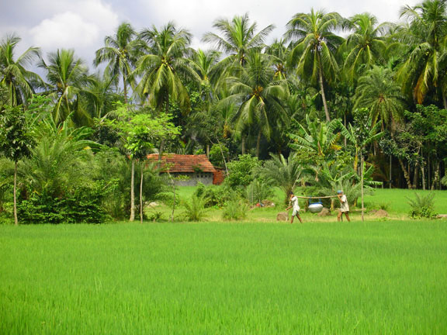
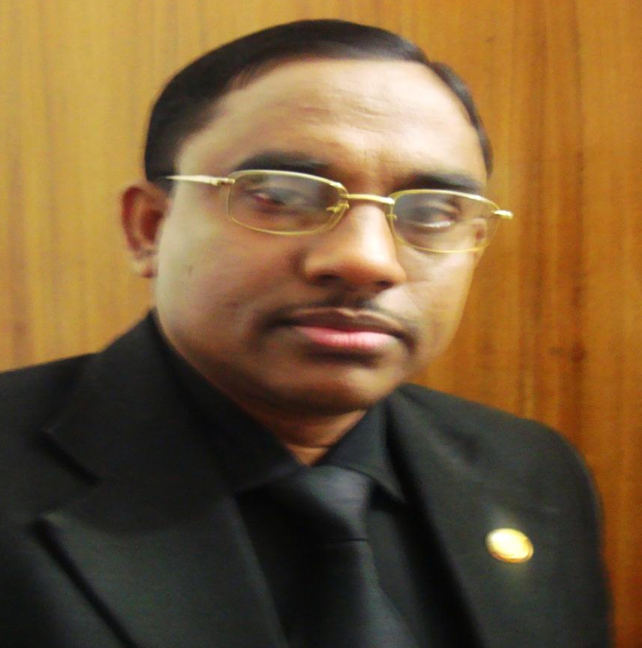
Welcome to the world of HHR Powerpint Presentation.
Good Morning

Slide 2
Introduction
Md Hasan Hafizur Rahman
Senior Lecturer
Department of English
Cambrian School & College
Dhaka.
Class-VIII
English First Paper
Notes:
Introduction of teacher & class.

Slide 3
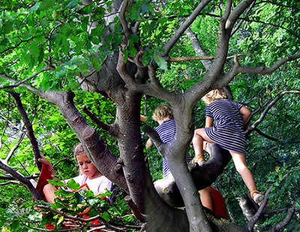
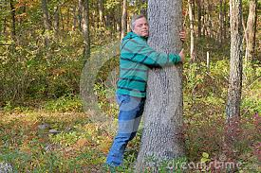
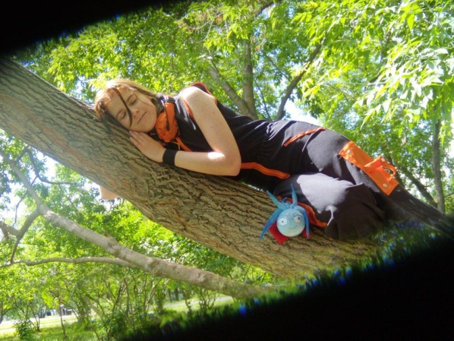
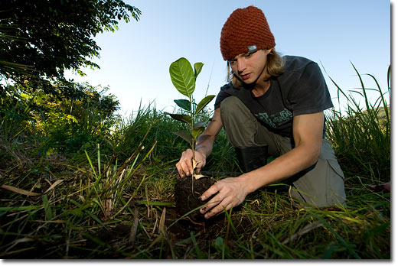
Tree lovers
Notes:
Suspension to take out loving tree.

Slide 4
Our Today’s Lesson is-
A Man Who Loves Tree
Unit-5, Lesson-4
Notes:
Lesson declaration.

Slide 5
Learning outcomes
At the end of the lesson we will be able to learn-
ask and answer questions
read and understand text through silent reading
infer meaning from context
write answer to questions
Notes:
All the four skill will be focused by this lesson.

Slide 6
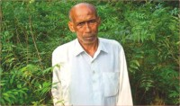
Do you know this person?
Notes:
Students may not answer the question. Just go to the next page.

Slide 7
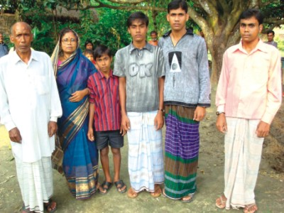

Let us introduce with him.
Name : Kartik Poramanik
Father : Suren Poramanik
Mother : Subas Bala
Village : Tarapur
Upazilla : Shibgonj
Dist. : Chapainawabgonj
Birth Year : 1942
Profession : Hair dresser
Passion : Planting trees
Quantity of pant : More than hundred.
Identity : Nature lover.
Notes:
Students will infer basic information from this page. Teacher may repeat the information. To avoid keyword option, teacher may use hyperlink.
To avoid key word display teacher may use hyperlink shown in this page.

Slide 8
Not for the students
Keywords
Teacher may show this option if time may allow. To conduct this portion teacher can show the word first to ask meaning, then he can advance according to animation.

Slide 9
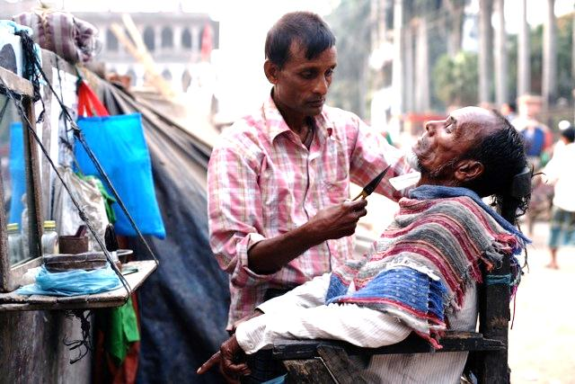
Profession
Meaning: Occupation, job, business
Kartik Poramanik is a hair dresser by profession.
Notes:
Teacher may show the word first to find out meaning of the word, then he may go according to the animations.

Slide 10
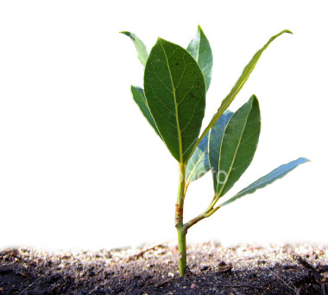
Sapling
Meaning: Seedling, plantlet, sprig
Kartik used to plant sapling.
Notes:
Teacher may show the word first to find out meaning of the word, then he may go according to the animations.

Slide 11

Mission
Meaning: Duty, operation, target
No vision is succeeded without a mission.
Notes:
Teacher may show the word first to find out meaning of the word, then he may go according to the animations.

Slide 12
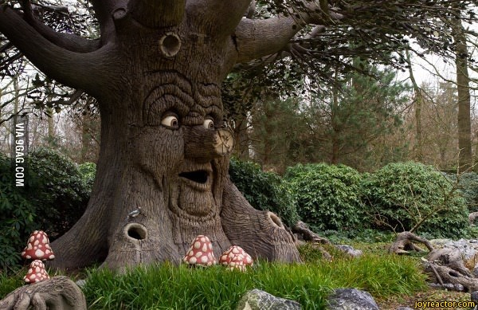
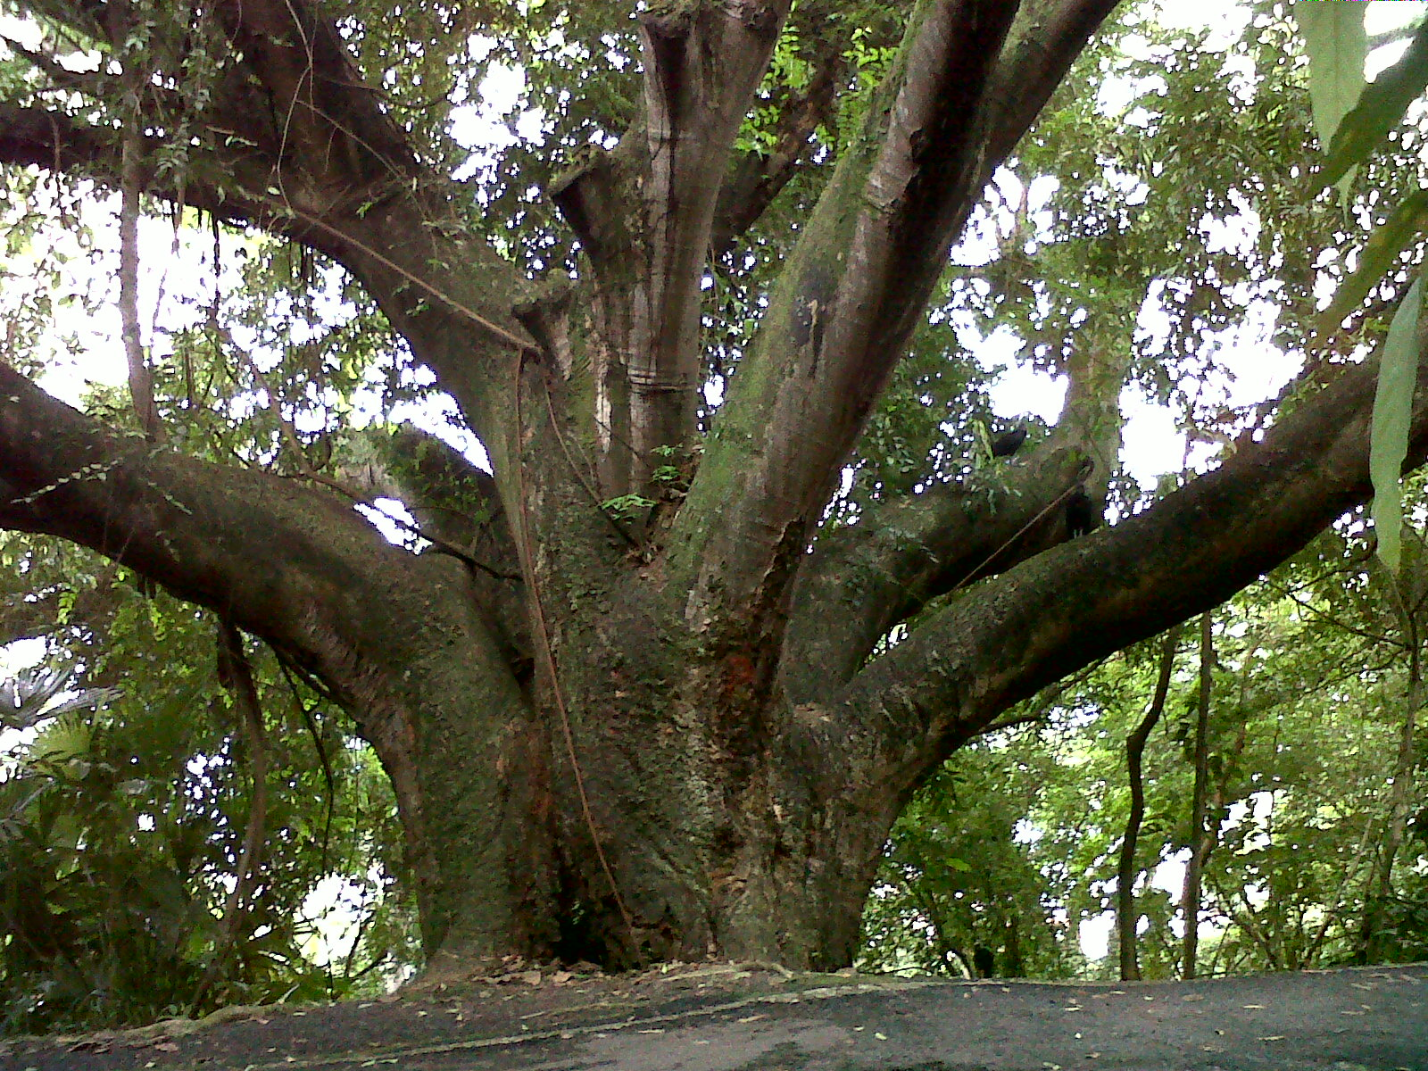
Gigantic
Meaning: Huge, massive, large
What a gigantic tree it is!
Notes:
In this slide a picture will be appeared first. Teacher may ask about the picture. Then he can show the main word. The he may go according to animations.

Slide 13
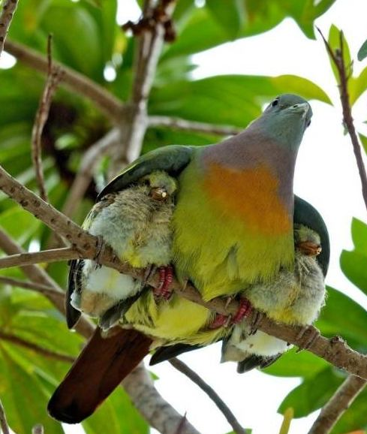
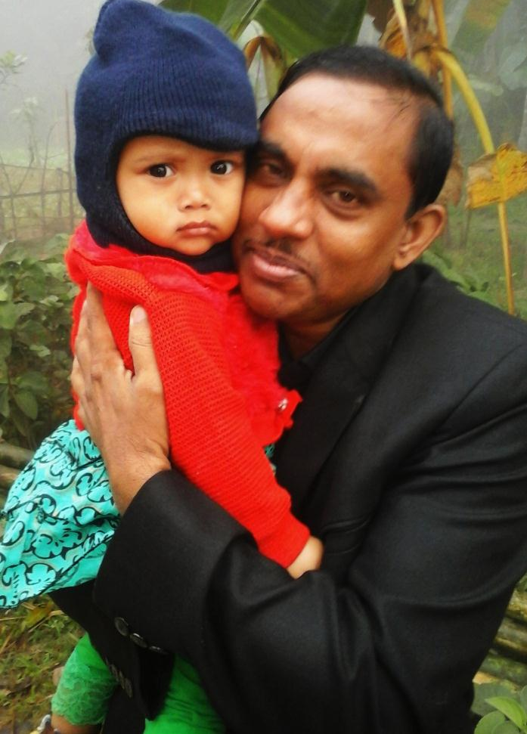
Passion
Meaning: Desire, love, appetite
These are the symbol of heavenly passion.
Notes:
Teacher may show the word first to find out meaning of the word, then he may go according to the animations.

Slide 14
Let us have a tour to the farthest corner of Bangladesh.
Notes:
Text information started from here. Loud reading by the teacher.

Slide 15
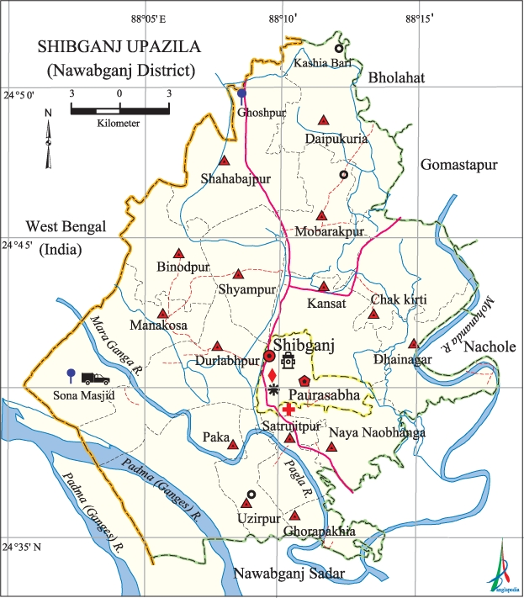
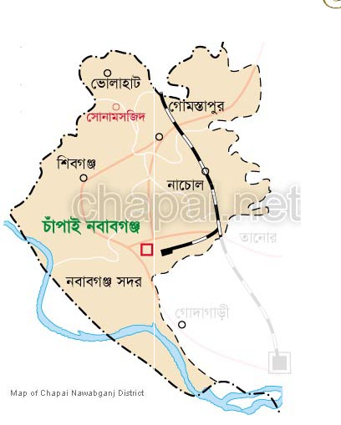
Shibgonj
Notes:
Click oval shape to indicate Shibgonj. Click Shibgonj to indicate shibgonj Upazilla map.

Slide 16
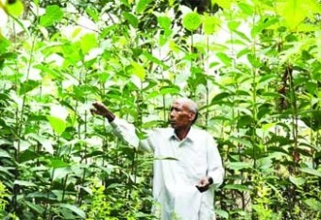
Tarapur
Kartik Poramanik lives in this village.
Notes:
Loud reading with proper sound, stress & intonation.

Slide 17
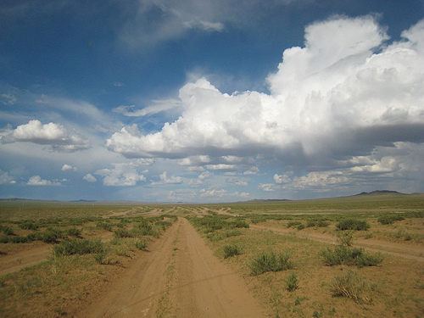
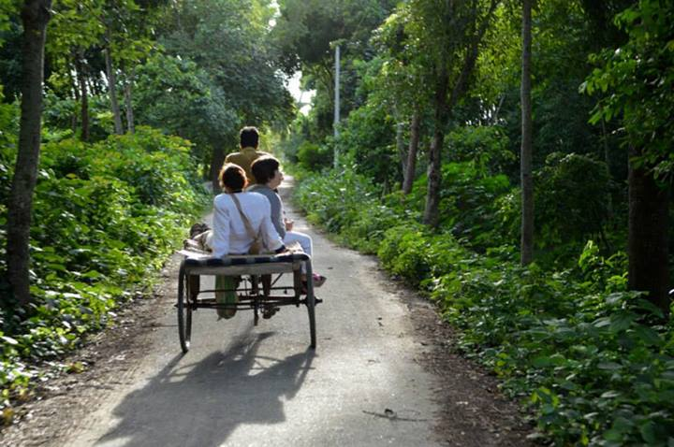
Before 72 years Tarapur was like
Present Tarapur
Without tree
Green Tarapur
Notes:
Loud discussion with proper sound, stress & intonation.

Slide 18
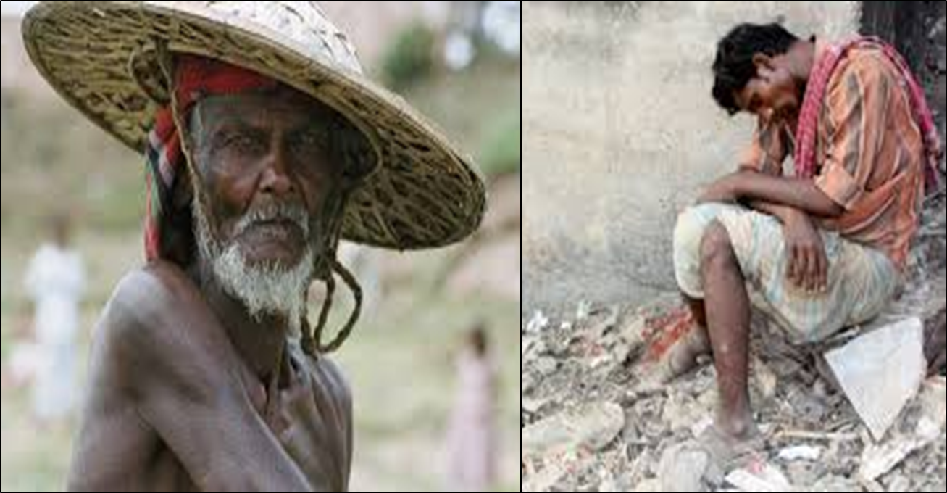
No shed, Kartik would get tired in the scorching sun like the pictures.
Notes:
Loud reading with proper sound, stress & intonation.

Slide 19
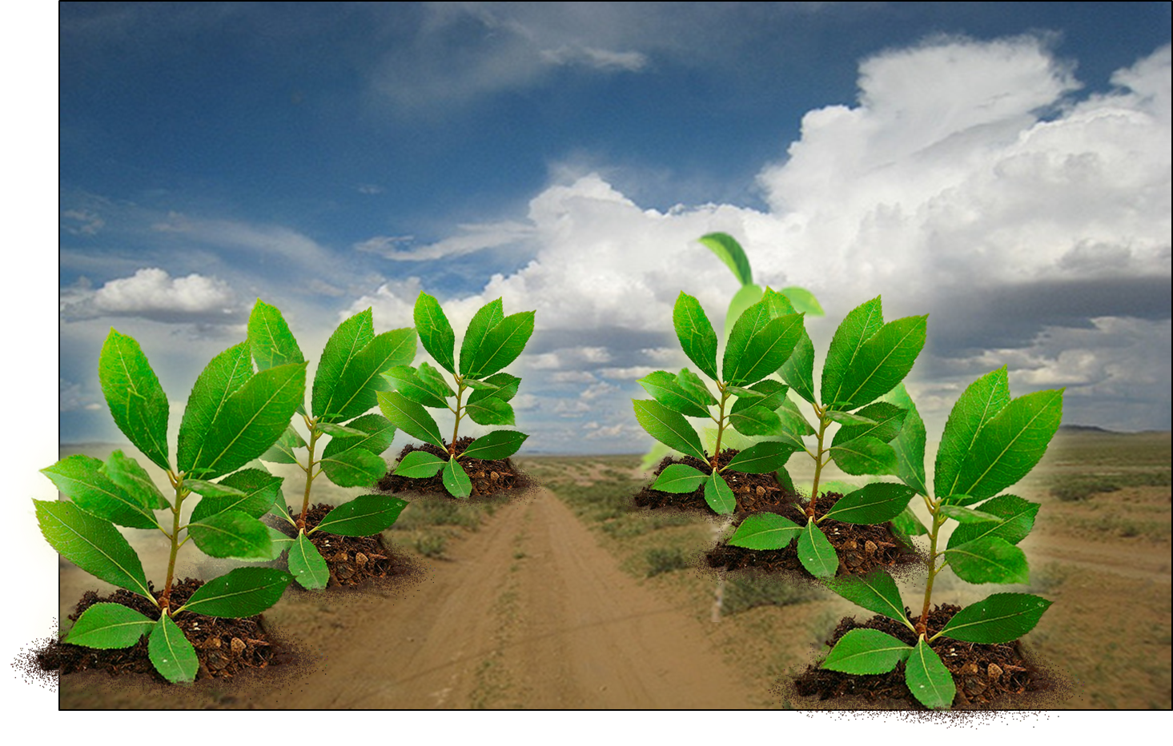

So, he began-
his tree planting mission at the age of ten.
Notes:
Loud reading with proper sound, stress & intonation.

Slide 20
Kartik would wake up early in the morning, take one or two labourers with him and set out to plant trees. He would walk long distances to plant trees, carrying with him some dry food and water. He would pay all the expenses from his own pocket. Kartik has planted trees beside the roads, in and round the bazar, schools and colleges, open fields and many other places. At times it so happened that Kartik would go to water his plants at 10 or 11 p m. People asked him, "Kartik, are you mad? What are you doing so late at night?" Kartik would smile and say, "What to do, sir. I have to work hard the whole day to earn money for my family. I don't get time during the day. But my trees would die if I don't water them. So I come late at night to look after them.“ Even today this old man continues planting trees as many as he can. A man, who can hardly sign his name, is leaving his signature all around in nature.
Now let us know the rest of his story by silent reading from the text book, page no - 54. (Kartik would woke up……all around in nature)
Notes:
This slide is just to show the location of the text book. May be used for the students who have not brought books.

Slide 21

B True or false? If false give the correct information.
  1 He planted the first tree 50 years ago.
  2 Katrik borrowed money from others to plant trees.
  3 He would plant trees around his hut only.
  4 At times Kartik would water his trees at night because he felt lazy during the day.
C Choose the best answer.
1 Karik was a …………… by profession.
a cultivator
b tree planter
c day labourer
d hair dresser
Notes:
Evaluation started. This option may be conducted orally.

Slide 22

2 His mission is to make the village green by………
  a cultivating paddy in the fields.
  b growing grass in all the fallow land.
  c planting fodder for the cattle.
  d planting many trees.
3 Some of Kartik’s trees are big and …………….
  a great.
  b gigantic.
  c enormous.
  d kingly.
4 Some of his trees are…………… years old.
  a 15 - 20
  b 25 - 35
  c 35 - 40
  d 40
Notes:
Evaluation option. This option may be conducted orally.

Slide 23

Home Work
D Read the text again and answer the following questions.
1 Who is Kartik Poramanik?
2 How do you understand that he is a nature lover?
3 Why did he plant trees?
4 What do you understand by the saying: “A man, who can hardly sign his name, is leaving his signature all around in nature?”
Notes:
Homework for next class.

Slide 24
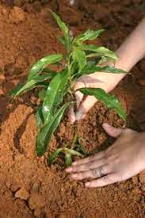
Plant tree
Save environment
Let us plant tree
and
save environment.
Notes:
Teacher may go according to click.

Slide 25
Allah Hafiz
Notes:
Ending slide.

Slide 26
Acknowledgement
We would like to express our cordial gratitude to the Ministry of Education, Directorate of Secondary & Higher Education, NCTB, A2i and the panel of honorable editors ( Md. Jahangir Hasan, Assistant Professor (English) TTC, Rangpur, Ranjit Poddar, Associate Professor (English) TTC, Dhaka, and Urmila Khaled, Assistant Professor (English) TTC, Dhaka, to enrich the contents.

